Slide 1
New Budget Standards for Low-Paid and Unemployed Australians – Project Design, Methods and Key Findings
Peter Saunders and Megan Bedford
Social Policy Research Centre
University of New South Wales
Seminar presentation to the Fair Work Commission
Monday 27 November 2017

Slide 2
Project Description and Objectives
‘A budget standard represents what a particular household, living in a particular place at a particular time, needs to attain (and sustain) a specific standard of living. The method used to develop the standards involve identifying needs and costing what is required to fulfil them in a way that is grounded in actual experience. This project will build on previous Australian and recent international research to develop a set of budget standards for low-paid and unemployed Australians and their families. The approach will incorporate expert judgements and behavioural evidence, and give emphasis to the views of relevant individuals to ensure that the standards are grounded in everyday experience and reflect real needs. The results will be used to inform debate and guide decisions about the levels of minimum wages and income support payments required to support healthy living consistent with individual needs and community expectations’

Slide 3
Background and Context
Budget standards have enduring appeal because they are consistent with a common understanding of how to estimate how much is needed to achieve a specific standard of living
Updates of the earlier SPRC budget standards have been used to guide the setting of the pension, foster care allowances, the minimum wage and superannuation benefits – but they are now over two decades old and out of date!
Uprating by the CPI takes no account of changes in ‘prevailing community standards’ and other factors that influence how a budget standard is developed
Budget standards research has been evolving rapidly:
The UK Minimum Income Standard (MIS) is updated annually and used to evaluate the impact of social policy (see www.minimumincomestandard.org)
The European Commission has funded a major project on developing a common methodology for Reference Budgets in EU countries (see paper by Goedemé et al. in The European Journal of Social Security, 2015)
Australian budget standards research is outdated and has not incorporated these recent developments

Slide 4
What is a Budget Standard?
A budget standard indicates how much money a family living in a particular place at a particular time needs to purchase the material goods and participate in the activities required to achieve and sustain a particular standard of living
The budgets are derived by specifying the standard and then identifying all of the items required to reach it, pricing each item and calculating the total weekly cost of the basket of items
The budget standards draw on three kinds of data: expert (normative) data that reflects prevailing judgements on how much is needed to achieve specific standards; behavioural (survey) data that describes the spending patterns of actual families; and experiential (focus group) data that captures how real families budget and make ends meet.
Budget standards are generally used to estimate the income levels required to achieve a minimally adequate standard of living – a level below which no one should be allowed to fall
They have a long history in Australia, stretching back to when Justice Higgins used them to underpin the basic wage levels set in the 1907 Harvester Judgement
Only a budget standards approach can establish not only whether a particular provision is adequate or not, but also the size of any shortfall (or excess)

Slide 5
Key General Features of the Project
A 3-year ARC Linkage project with Partner Organisations Catholic Social Services Australia (CSSA), United Voice - National Office (UV) and ACOSS, guided by a Project Reference Group with PO contacts and three independent experts
Starting point was the original low cost SPRC budgets, developed and priced in February 1997, revised to reflect new research methods, availability of new data and two decades of practical hands-on experience (and criticism!)
The methodology employs three kinds of data (normative; behavioural; experiential) derived from three main sources (experts; social surveys; focus groups)
Unlike in the UK (but similar to the recent EU study) the focus group content has not been given a greater role or been more deliberative
‘The key debate is over their role – should it be in decision-making or validating? In the UK … the approach moved from one where the experts designed the budget that was validated by focus groups, to one whereby the focus groups design and decide and the experts validate’ (Vranken, EU Synthesis Report, 2010)
New budgets have been developed for single people, sole parent families and couples with and without children with one adult who is either in low-paid work or unemployed
Project Report (and a shorter Summary Report) were released in August 2017. They are available at: https://www.sprc.unsw.edu.au/research/projects/a-new-healthy-living-minimum-income-standard-for-low-paid-and-unemployed-australians/

Slide 6
Some Key Differences from Earlier Study
Specification of the underlying standard – replacement of the Modest but Adequate (MBA) & Low Cost (LC) standards by the Minimum Income for Healthy Living (MIHL) standard (drawn from the UK public health literature)
From hypothetical to representative families (implies greater reliance on behavioural approach)
The role of the focus groups was constrained by the difficulties encountered in recruiting low-paid workers
Budgets were derived first for low-wage families and then modified to suit unemployed families
The main budget areas were changed slightly to maintain consistency with the ABS expenditure categories
Housing costs were calculated separately and added on to the non-housing budgets later (to produce the “grossed-up” budgets)
The “grossed-up” budgets were varied several times to ensure consistency with external evidence about the relative circumstances of different families – this was a time-consuming process because it often required several steps to achieve appropriate horizontal (between-families) and vertical (low-paid vs. unemployed) relativities. (Obtaining retrospective price and other data was often difficult)
Errors/incomplete documentation of the earlier study had to be identified and corrected

Slide 7
Family Types
Low-paid working families | Unemployed families
W1 Single person (female,35; male,40) | U1 Single person (female,35; male,40)
W2 Couple (M,40 & F,35) without children | U2 Couple (M,40 & F,35) without children
W3 Couple as above with girl,6 | U3 Couple as above with girl,6
W4 Couple as above with girl, 6 and boy, 10 | U4 Couple as above with girl,6 and boy,10
W5 Sole parent (F,35) with girl,6 | U5 Sole parent (F,35) with girl,6

Slide 8
Some Key Practical Issues
Difficulty encountered recruiting for focus groups
Setting item lifetimes
Importance of the assumptions underlying child care costs
Inclusion of a car?
Variation in housing costs
Drawing on past experience to revise the previous budgets
Finalising the new budgets: achieving external validity and internal consistency
Moving from the low-paid to the unemployed budgets involved a combination of: removing items; lowering item quality; cutting costs (e.g. by extending lifetimes and/or increased reliance on Home-brand items); reducing frequencies – but budgets still had to be consistent with the MIHL standard

Slide 9
Setting Dwelling Types and Location
Family type | Low-paid working families | Unemployed families
Single person | 1BRU, (LQ+M)/2, AMCC | 1BRU, LQ, AOCC
Couple without children | 2BRU, (LQ+M)/2, AMCC | 2BRU, LQ, AOCC
Couple as above with girl, 6 | 2BRU, (LQ+M)/2, AMCC | 2BRU, LQ, AOCC
Couple as above with girl, 6 and boy, 10 | 3BRH, (LQ+M)/2, AMCC | 3BRH, LQ, AOCC
Sole parent with girl, 6 | 2BRU, (LQ+M)/2, AMCC | 2BRU, LQ, AOCC
Notes: 1/2/3BRU = 1/2/3–bedroom unit; 3 BRH = 3 bedroom house; LQ = lower quartile rent; M = median rent; AMCC
=Average for middle suburbs in Sydney, Brisbane and Melbourne; AOCC = Average for outer suburbs in Sydney,
Brisbane and Melbourne.

Slide 10
Average Rents for Assigned Dwellings
 |  |  |  |  |  |  | Average rents in:
Standard / Dwelling Type | Sydney | Canberra | Brisbane | Adelaide | Hobart | Melbourne | Sydney, Brisbane & Melbourne | All 6 capitals
Low-paid families:
1BRU,(LQ+M)/2, Middle | 420 | 275 | 270 | 200 | 175 | 257.5 | 315.8 | 266.3
2BRU, (LQ+M)/2,Middle | 452.5 | 351.8 | 360 | 265 | 231.5 | 365 | 392.5 | 337.6
3BRH, (LQ+M)/2, Middle | 532.5 | 442.5 | 400 | 355 | 312.5 | 440 | 457.5 | 413.8
Unemployed families:
1BRU, LQ, Outer | 280 | 250 | 180 | 141 | 135 | 210 | 223.3 | 199.3
2BRU, LQ, Outer | 350 | 350 | 260 | 230 | 276 | 280 | 296.7 | 291
3BRH, LQ, Outer | 400 | 390 | 300 | 270 | 284 | 320 | 340 | 327.3
Source: Real Estate Market Facts, March Quarter 2016, Tables 9, 10, 13, 14, 21, 22, 25, 26, 29, 30, 33 & 34.

Slide 11
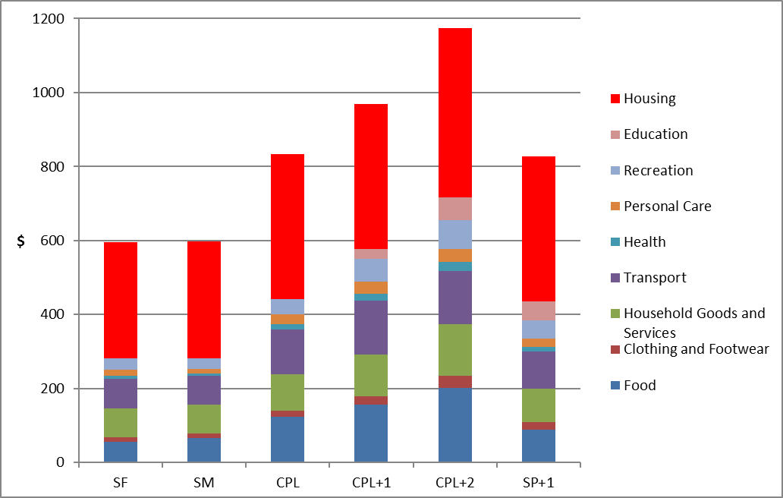
The New Low-Paid Budget Standards ($ per week, June 2016)
Note: SF = single female; SM = single male; CPL = couple; CPL+1 = couple plus 6 year old girl; CPL+2 = couple
plus 6 year old girl and 10 year old boy; SP+1 = sole parent plus 6 year old girl

Slide 12
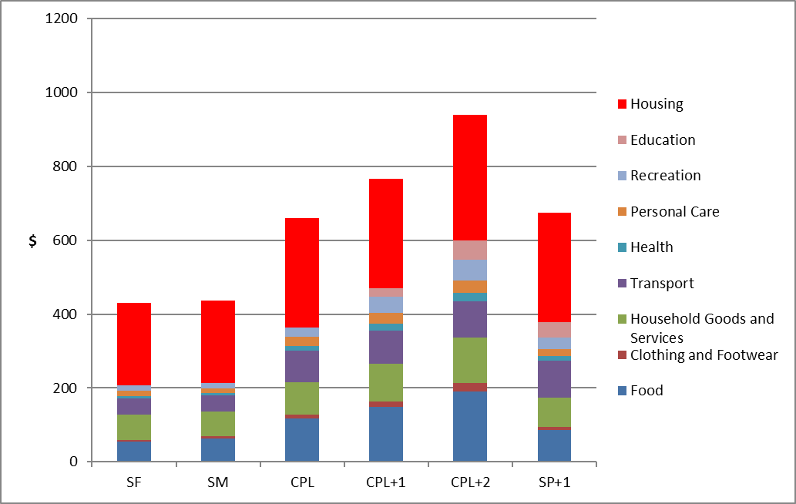
The New Unemployed Budget Standards ($ per week, June 2016)
Note: SF = single female; SM = single male; CPL = couple; CPL+1 = couple plus 6 year old girl; CPL+2 = couple
plus 6 year old girl and 10 year old boy; SP+1 = sole parent plus 6 year old girl

Slide 13
Estimated Costs of Children ($ per week, June 2016)
Family Type | Low-Paid | Unemployed
Couple with no children | 833.24 | 660.25
Couple with 6 year-old girl | 969.90 | 766.74
Difference | 136.66 | 106.49
Couple with 6 year-old girl | 969.90 | 766.74
Couple with 6 year-old girl and 10 year-old boy | 1173.38 | 940.37
Difference | 203.48 | 173.63
Couple with no children | 833.24 | 660.25
Couple with 6 year-old girl and 10 year-old boy | 1173.38 | 940.37
Difference | 340.14 | 280.12
Difference per child | 170.07 | 140.06

Slide 14
Implied Horizontal and Vertical Relativities ($/week, June 2016)
Family type (OECD modified and SQ(N) relativities in brackets) | Low-paid budget relativities (1) | Unemployed budget relativities (2) | Family relativities (2) /(1)
Single adult (1.00/1.00) | 597.3 (1.00) | 433.7 (1.00) | 0.73
Couple (1.50/1.41) | 833.2 (1.39) | 660.3 (1.52) | 0.79
Couple + girl, 6 (1.80/1.73) | 969.9 (1.62) | 766.7 (1.77) | 0.79
Couple + girl, 6 & boy, 10 (2.10/2.00) | 1173.4 (1.96) | 940.4 (2.17) | 0.80
Sole parent + girl, 6 (1.30/1.41) | 827.7 (1.39) | 675.2 (1.56) | 0.82

Slide 15
Comparisons with Existing Poverty Lines ($ per week, June 2016)
Family type | Henderson poverty line (head in the workforce) | Poverty line set at 50% of median income (1) | Low-paid grossed-up budget standard (2) | Ratio: (2)/(1) | Unemployed grossed-up budget standard (3) | Ratio: (3)/(1)
Single person | 530.13 | 441.18 | 597.31 | 1.354 | 433.68 | 0.983
Couple, no children | 709.17 | 661.78 | 833.24 | 1.259 | 660.25 | 0.998
Couple, one child | 852.46 | 794.12 | 969.90 | 1.221 | 766.74 | 0.965
Couple, two children | 995.75 | 926.48 | 1,173.38 | 1.266 | 940.37 | 1.015
Sole parent, one child | 680.59 | 563.43 | 827.70 | 1.469 | 675.18 | 1.198

Slide 16
Assessing the Adequacy of the Social Safety Net
Family type | Low-paid |  |  | Unemployed
 | Grossed-up Budget Standard (1) | Safety net Income (2) | (2) minus (1) | Grossed-up Budget Standard (1) | Safety net Income (2) | (2) minus (1)
Single adult | 597.31 | 659.22 | 61.91 | 433.68 | 337.68 | -96.00
Couple with no children | 833.24 | 794.21 | -39.03 | 660.25 | 552.84 | -107.41
Couple with one child | 969.90 | 978.74 | 8.84 | 766.74 | 708.28 | -58.46
Couple with two children | 1173.38 | 1084.64 | -88.74 | 940.37 | 814.13 | -126.24
Sole parent with one child | 827.70 | 872.56 | 44.86 | 675.18 | 627.79 | -47.39

Slide 17
Concluding Reflections
The task of ‘updating an existing set of budget standards’ has proved to be far more demanding than was originally anticipated
The task would be far easier (and more valuable) if it was conducted more frequently and regularly
The results indicate that existing social safety net provisions provide an adequate floor for low-paid single adults receiving the minimum wage and working full-time but not for those with a partner or children
For the unemployed reliant on the Newstart Allowance, the safety net provisions fall short of the budget standards estimates by $96 for a single person and $126 for a couple with two children
The average cost of a child aged between 6 and 10 years is estimated to be $170 a week at the low-paid standard and $140 a week at the unemployed standard
Housing costs are the largest budget item and vary by dwelling size, but also by location: the results raise important issues about how to estimate housing costs and how the safety net system should take account of them
The findings raise questions about whether a similar mechanism to that used to set and vary the minimum wage should be applied to NSA (and other social security benefits)
Budget standards are not a panacea but they provide important information that can inform and assist decisions taken about adequacy – at the very least, they open up debate about the meaning of adequacy, what is needed to achieve it and how the associated costs can be identified and estimated

