Slide 1

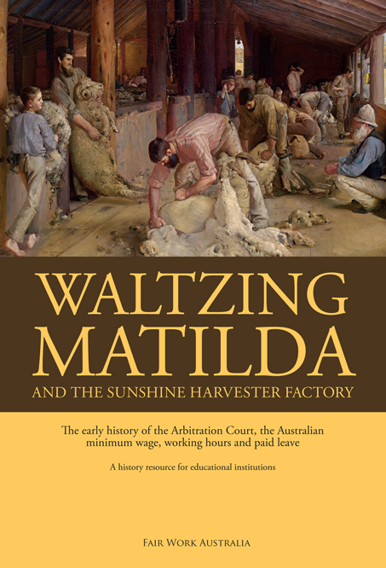

Slide 2
‘Waltzing Matilda’ and the great strikes: The origins of the Commonwealth Court of Conciliation and Arbitration
Part One

Slide 3
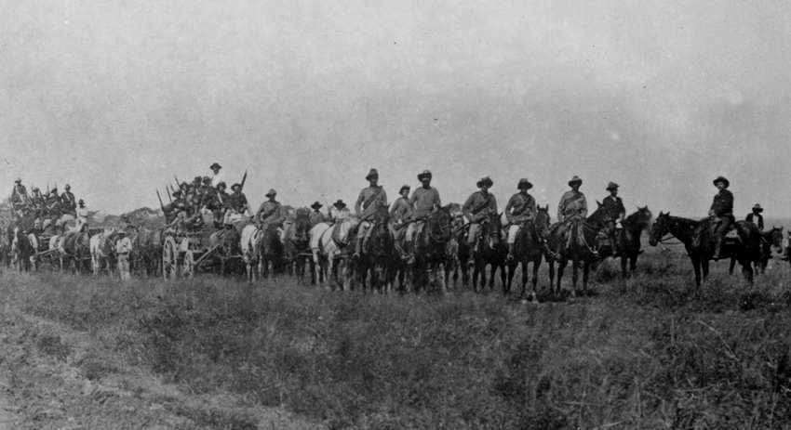
Waltzing Matilda and the great strikes
An armed uniformed escort removing striking shearers during the 1891 ‘Great Strike’, near Hughenden, Queensland.

Slide 4
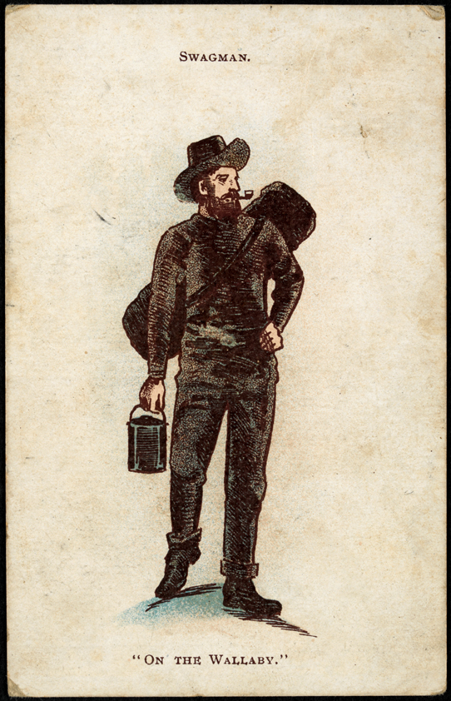
Waltzing Matilda and the great strikes
A postcard from the early 1900s.

Slide 5
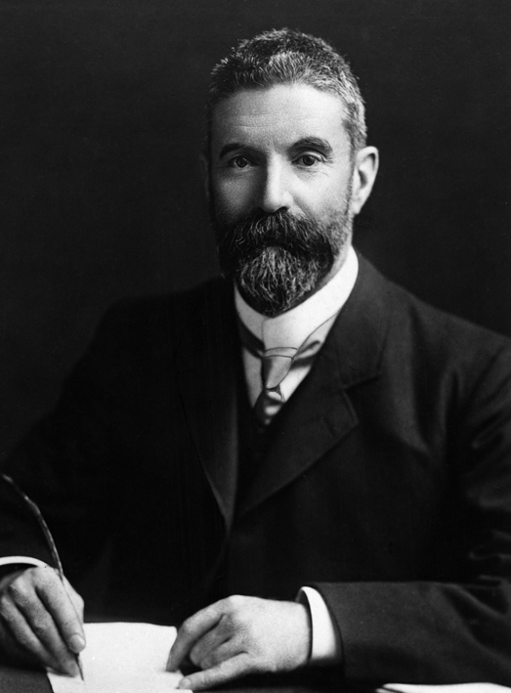
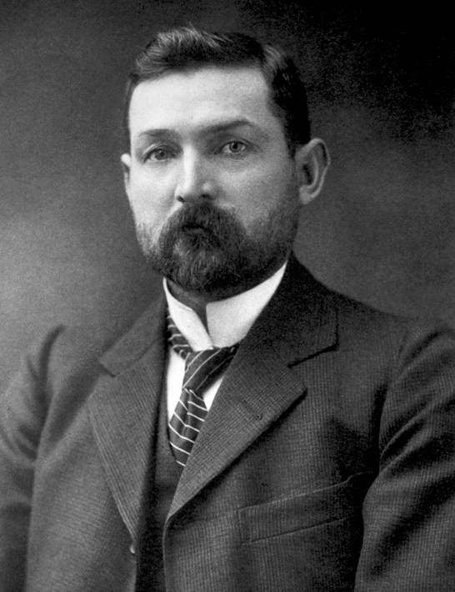
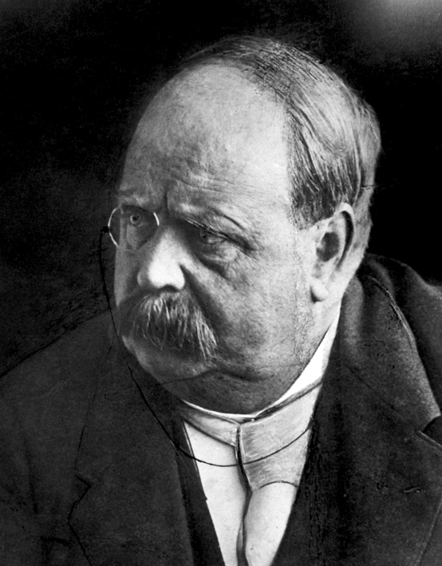
Waltzing Matilda and the great strikes
The Hon Alfred Deakin (1856–1919). He was Prime Minister of Australia three times, for a brief period in 1903 and then from July 1905 to November 1908 and from June 1909 to April 1910. He was the most influential political supporter of the establishment of the Arbitration Court.
John Christian Watson (1867–1941). He was Prime Minister in 1904 from April to August in a short lived minority government. His party was a strong supporter of the Arbitration Court.
Sir George Houstoun Reid (1845–1918). He was Prime Minister of Australia from 18 August 1904 to 5 July 1905. His position was ‘yes/no’ on the Arbitration Court. The Act establishing the Court passed while he was Prime Minister.

Slide 6
Waltzing Matilda and the great strikes
1788 Colony of New South Wales begins. Regulations on the work of convicts.
1828 Masters and Servants Act 1828—master–servant relationship.
1855-60 Democratic self-government in New South Wales, Victoria, South Australia, Queensland and Tasmania. Western Australia remains under Colonial Office rule.
1873 Victorian Shops and Factories Act 1873 regulates safety, etc. in factories.
1881 New South Wales Trade Union Act 1881 recognises trade unions, other states follow. Trade union members can still be convicted of criminal conspiracy, and are in the 1891 shearers’ strike.
1890s The great strikes—1890 maritime strike, 1891 shearers’ strike, 1894 shearers’ strike, 1892 Broken Hill strike. Trade unions defeated. The memory of the bitter disputes would haunt the colonies, and be remembered in ‘Waltzing Matilda’.

Slide 7
Waltzing Matilda and the great strikes
1890 Charles Kingston introduces compulsory Conciliation and Arbitration Bill—the later model for Australia.
1891 New South Wales Royal Commission on Strikes—strikes ‘the great social problem of the age’. Henry Lawson writes ‘Freedom on the Wallaby’.
1892 New South Wales Parliament establishes a system of ‘voluntary
conciliation and arbitration’ with the Trade Disputes Conciliation and Arbitration Act 1892—defunct in 1894.
1895 ‘Waltzing Matilda’ written by Banjo Paterson.
1895 George Reid’s New South Wales compulsory conciliation Bill defeated.
1896 Arbitrated awards and minimum wages begin in Victoria.
The Constitutional Convention resolves to include a conciliation and arbitration power in the proposed Australian Constitution.
1901 New South Wales compulsory Industrial Arbitration Act 1901.

Slide 8
Waltzing Matilda and the great strikes
1901 Australian Constitution gives the Australian Parliament the power to legislate on conciliation and arbitration (s.51(35) of the Constitution).
1901 First federal election—compulsory arbitration generally supported by most political groups and candidates.
1902 26 March 1902 Prime Minister Edmund Barton decides not to introduce the Conciliation and Arbitration Bill due to lack of parliamentary time.
7 July 1903 Charles Kingston obtains leave to introduce the Conciliation and Arbitration Bill into Parliament. The Bill is not introduced but is printed in The Age newspaper.
1903 28 July 1903 Alfred Deakin, Attorney-General, introduces the Conciliation and Arbitration Bill into the Australian Parliament for the first time. The Bill is withdrawn by the government on 8 September after the Labor Party amends it to cover state railway employees.

Slide 9
Waltzing Matilda and the great strikes
1903 Second federal election—compulsory arbitration generally supported by most political groups and candidates.
1904 22 March 1904 Prime Minister Alfred Deakin introduces the second Conciliation and Arbitration Bill.
1904 The Conciliation and Arbitration Bill is approved by the Australian Parliament on 9 December 1904 during the George Reid/Allan McLean Government. The Bill is proclaimed and becomes law on 15 December 1904.
1905 10 February 1905 Richard O’Connor appointed first president of the Commonwealth Court of Conciliation and Arbitration.
1906-07 The Court makes its first two awards. They cover the industries of the great strikes—maritime and shearing.

Slide 10
Establishing an Australian minimum wage
Part Two

Slide 11
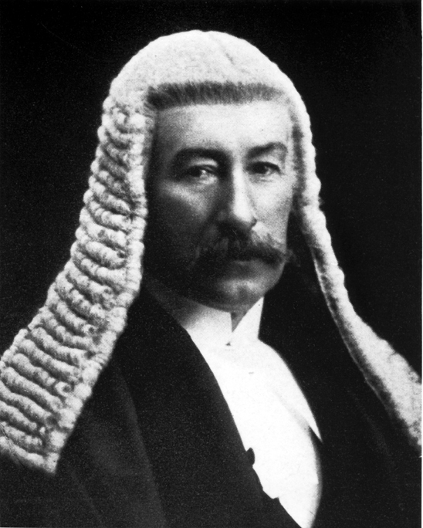
Establishing an Australian minimum wage
The Hon Henry Bournes Higgins (1851–1929).
President of the Commonwealth Court of
Conciliation and Arbitration 1907 to 1921. He
handed down the Harvester Decision, which
established 7 shillings a day for an unskilled labourer as a fair and reasonable wage. It became the basis of the Australian minimum wage.

Slide 12
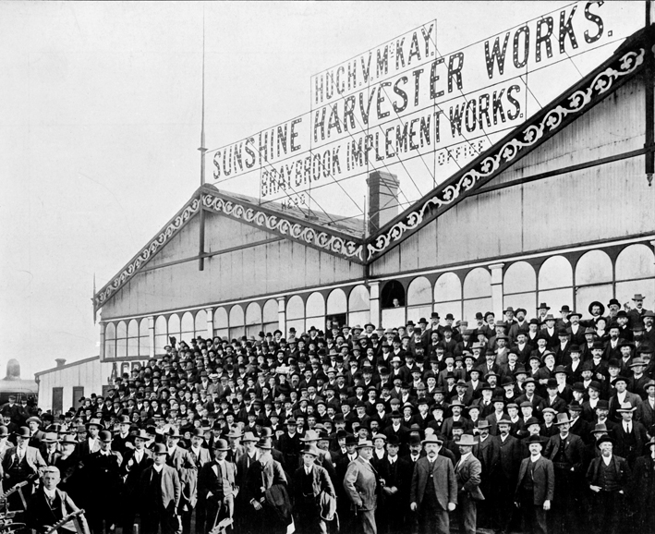
Establishing an Australian minimum wage
1500 farmers visit HV McKay Sunshine Harvester Works at the invitation of Mr McKay, September 1911.

Slide 13
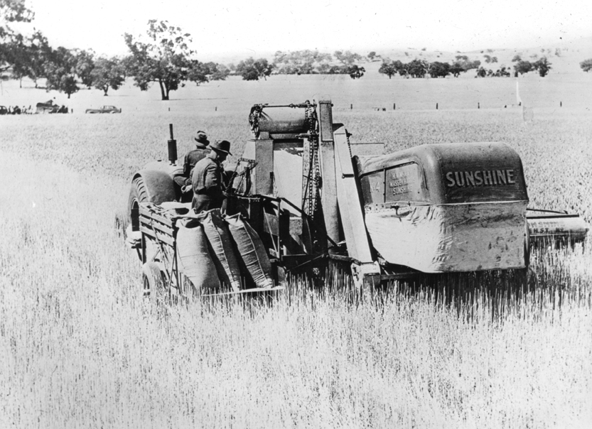
Establishing an Australian minimum wage
A Sunshine ‘modern’ harvester.

Slide 14
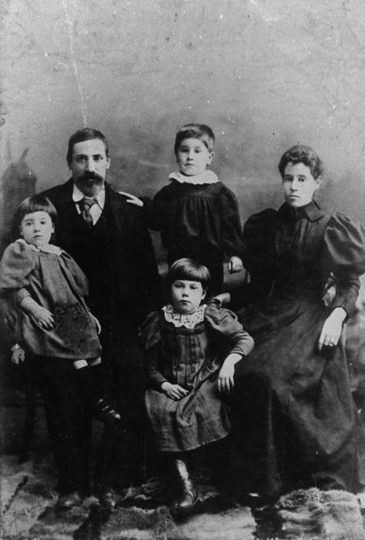
Establishing an Australian minimum wage
Working class family in their ‘Sunday best’, Richmond, Victoria early 1900s.

Slide 15
Establishing an Australian minimum wage
1907 The Harvester Decision establishes 7 shillings a day, or 42 shillings a week, minimum wage for an unskilled labourer. A ‘family’ or ‘living’ wage is established on the basis of ‘needs’ of a worker to support a family of five. This applies only to one company and the decision is overturned by the High Court.
1908 The Commonwealth Court of Conciliation and Arbitration adopts the Harvester 7 shillings and applies it in awards for the first time. Additional amounts are paid to more skilled employees. These additional amounts become known as ‘margins’. Only 20 awards are made between 1905 and 1914 by the Court so the 7 shillings has very limited coverage. Most awards are state awards with a lower minimum wage of 36 shillings a week.
1912-19 The Commonwealth Statistician establishes the first statistics on inflation, the ‘A’ Series.

Slide 16
Establishing an Australian minimum wage
1912 A minimum wage for some jobs performed mainly or exclusively by women, such as a fruit packer or milliner, set at 54 per cent of the male minimum wage in the Fruit Pickers Case and other cases. The wage is set on the basis of needs of a woman, not the need to support a family. Most women are not in the formal workforce.
The Harvester 7 shillings is increased by the ‘A’ series estimate of inflation, to maintain the buying power of the minimum wage.
1919 Royal Commission on the Basic Wage estimates a higher minimum wage needed to meet the ‘needs’ of working men.
1920s The Harvester minimum wage of 7 shillings a day, or 42 shillings a week, as increased, is adopted by state industrial tribunals in place of lower minimum wages, often 36 shillings a week. The Harvester minimum wage is now the national minimum wage covering most Australian employees.

Slide 17
Establishing an Australian minimum wage
1921 Gas Employees Case: The Court rejects the royal commission estimated amount as unsustainable. Maintains the lower Harvester minimum wage. End of a needs-based wage?
The Court includes a clause in awards automatically adjusting the Harvester minimum wage by amounts of inflation each three months.
1953 Quarterly indexation abandoned.
1966 Aboriginal Stockmen’s Case removes the exemption from awards for Aboriginal stockmen. One award wage now applies to both Aboriginal and non-Aboriginal stockmen.
Equal Pay Case continues separate minimum wage for women.
1972 Equal Pay Case removes separate minimum wage for women. One award wage now applies to both men and women.
1974 In the National Wage Case the Commission formally abandons a ‘family wage’.

Slide 18
The campaigns for equal pay for women and Aboriginal stockmen and minimum wages for adolescents
Part Three

Slide 19
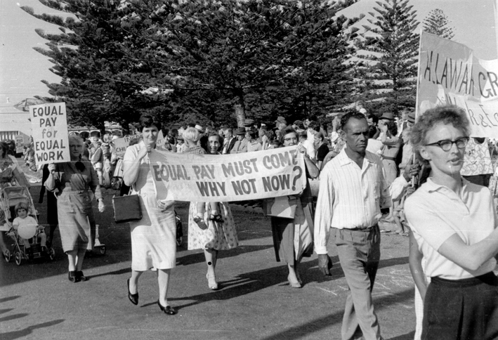
The campaigns for equal pay
March for equal pay during the May Day parade, Fremantle, 1965.

Slide 20
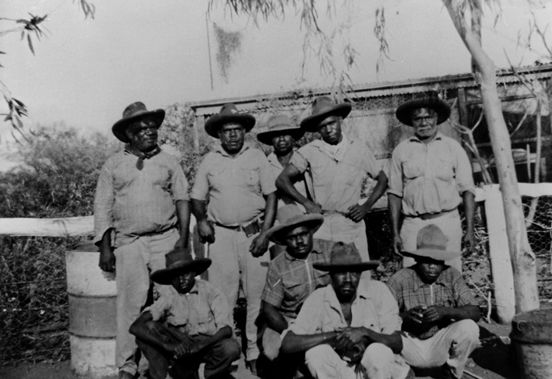
The campaigns for equal pay
Aboriginal stockmen at Waterloo station, in the western Victoria River district of the Northern Territory, 1954.

Slide 21
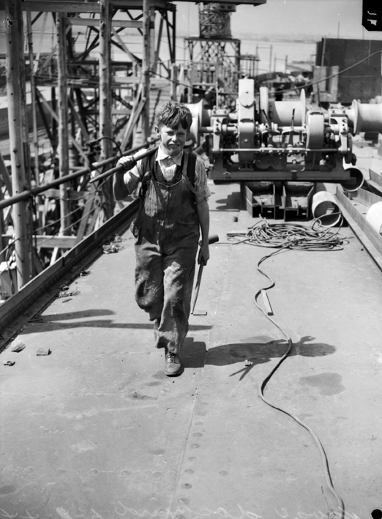
The campaigns for equal pay
Jack Howe, a 15 year old apprentice in Victoria in 1944. He is pictured carrying tools to the tradesmen working on the construction of a 10 000 ton merchant navy ship at the Naval Dockyard, Williamstown, Victoria.

Slide 22
The campaigns for equal pay
1907 Harvester Decision includes rates of pay for young people and apprentices which are less than adult rates.
1907-30s The Court prefers to set special apprenticeship rates rather than junior rates in federal awards without obligation to train young people, acts to protect adult jobs from lower junior rates by a ratio of apprentices to tradespeople. The Court sometimes regulates the form of the training contract.
1912-19 Fruit Pickers Case and Clothing Trades Case: The Court sets rates of pay for women under federal awards at 54 per cent of male rates (i.e. the ‘basic wage’). If women work in competition with males (e.g. as a fruit picker or blacksmith) the female rate is the same as the male rate. If women work in jobs mainly performed by women (e.g. fruit packer or milliner), then they receive the lower 54 per cent of the male minimum wage. Females usually receive lower extra payments for skill (i.e. ‘margins’).

Slide 23
The campaigns for equal pay
WWII Special regulations set female rates at 75 per cent of the male rate.
1949–50 The 75 per cent rate adopted for federal awards.
Aboriginal Stockmen’s Case: Aboriginal stockmen gain the same federal award rates as non-Aboriginal stockmen.
1969 Equal Pay Case: Special female award rates maintained in federal awards.
1972 Equal Pay Case: Special female award rates abandoned in federal awards. There is to be only one award rate, applying to both males and females.

Slide 24
Leave and other entitlements
Part Four

Slide 25
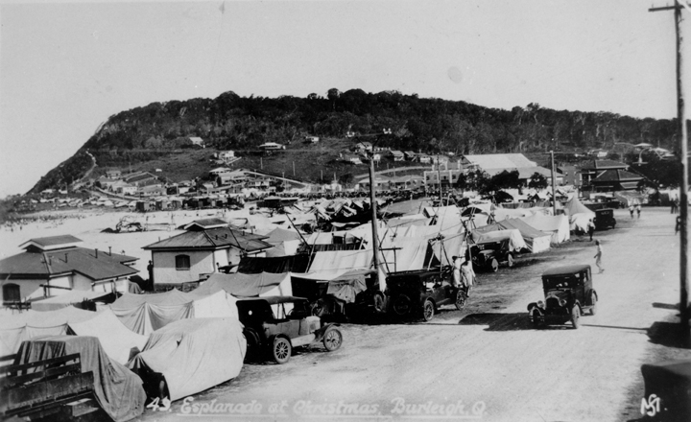
Leave and other entitlements
The Esplanade at Burleigh, Queensland, crowded with tents and cars during the Christmas holidays, 1932.

Slide 26
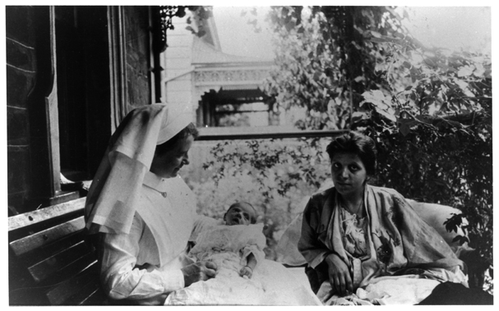
Leave and other entitlements
Mrs GG Nicolaides at her home in Unley, South Australia, with her baby daughter Loulla, and Nurse Stacey, 1921.

Slide 27
Leave and other entitlements
1856 Eight-hour day introduced for Victorian stonemasons.
1900s 48 hours per week the standard, except for exploitative workplaces. No sick leave, parental leave, or annual leave. If an employee is absent on illness or injury he or she may eventually be dismissed.
1906 10 days paid leave of absence introduced into federal maritime award.
1907 First mention of sick leave in federal awards. Shearer entitled to absent himself from work if ill.
1913 21 days paid leave of absence in federal award for telegraph employees.
1922 Six days sick leave introduced into the federal Engineers’ Award.
1927 44-hour standard week introduced into federal awards.
1935 Federal test case introduces one week’s paid annual leave into federal awards.

Slide 28
Leave and other entitlements
1930s-70s Gradual development in most federal awards of 10 days paid sick leave per year, which accumulates each year, with safeguards such as medical certificate requirements. Gradual development of four weeks annual leave entitlements.
1947 Federal test case introduces 40-hour standard week.
1973 Federal public servants granted 12 weeks paid maternity leave if 12 months service completed.
1979 Federal test case introduces a standard 12 months unpaid maternity leave into federal awards.
1983 38-hour standard week introduced by agreement if there are offsets.
1985 Federal test case extends 12 months unpaid parental leave to mothers who adopt children.

Slide 29
Leave and other entitlements
1990 Federal test case extends 12 months unpaid parental leave to fathers.
1990s Three federal test cases combine sick leave and other forms of leave into ‘personal/carer’s leave’.
2001 Federal test case extends 12 months unpaid parental leave to certain casual employees.

